Slide 1
Function Point Metrics

Slide 2
Productivity measures
Size related measures
  Based on some output from the software process.
  This may be lines of delivered source code, object code instructions, etc.
Function-related measures
  Based on an estimate of the functionality of the delivered software.
  Function-points are the best known of this type of measure.

Slide 3
Introduction
A function can be defined as a collection of executable statements that performs a certain task, together with declarations of the formal parameters and local variables manipulated by those statements (Conte et al., 1986).

Slide 4
Why Opt for FP Measures?
Independent of programming language. Some programming languages are more compact, e.g. C++ vs. Assembler.
Use readily countable characteristics of the “information domain” of the problem.
Does not “penalize” inventive implementations that require fewer LOC than others.
Makes it easier to accommodate reuse and object-oriented approaches.

Slide 5
Function points
Based on a combination of program characteristics:
  external inputs and outputs;
  user interactions;
  external interfaces;
  files used by the system.
A weight is associated with each of these and the function point count is computed by multiplying each raw count by the weight and summing all values.

Slide 6
Function points
The function point count is modified by complexity of the project
FPs can be used to estimate LOC depending on the average number of LOC per FP for a given language
  LOC = AVC * number of function points;
  AVC is a language-dependent factor varying from 200-300 for assemble language to 2-40 for a 4GL;
FPs are very subjective. They depend on the estimator
  Automatic function-point counting is impossible.

Slide 7
Object points
Object points (alternatively named application points) are an alternative function-related measure to function points when 4Gls or similar languages are used for development.
Object points are NOT the same as object classes.
It is a weighted estimate of:
  The number of separate screens that are displayed;
  The number of reports that are produced by the system;
  The number of program modules that must be developed to supplement the database code;

Slide 8
Object point estimation
Object points are easier to estimate from a specification than function points as they are simply concerned with screens, reports and programming language modules.
They can therefore be estimated at a fairly early point in the development process.
At this stage, it is very difficult to estimate the number of lines of code in a system.

Slide 9
Function Count
Alan Albrecht while working for IBM, recognized the problem in size measurement in the 1970s, and developed a technique (which he called Function Point Analysis), which appeared to be a solution to the size measurement problem.

Slide 10
FPA
The principle of Albrecht’s function point analysis (FPA) is that a system is decomposed into functional units:
  Inputs : information entering the system
  Outputs : information leaving the system
  Enquiries : requests for instant access to information
  Internal logical files : information held within the system
  External interface files : information held by other system that is used by the system being analyzed.

Slide 11
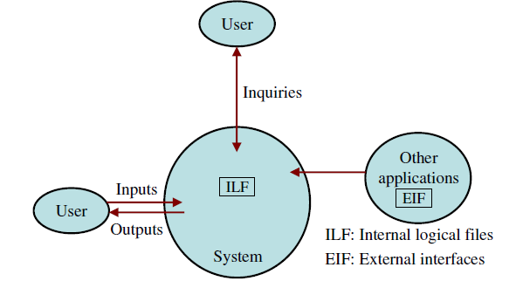
FPA functional units

Slide 12
Categories of Functional Units
Data function types
Internal Logical Files (ILF): A user identifiable group of logical related data or control information maintained within the system.
External Interface files (EIF): A user identifiable group of logically related data or control information referenced by the system, but maintained within another system.
Note: EIF counted for one system, may be an ILF in another system.

Slide 13
FPA
Transactional function types
External Input (EI): Data or control information that comes from outside the system.
External Output (EO): Process that generates data or control information to be sent outside the system.
External Inquiry (EQ): Elementary process that is made up to an input-output combination that results in data retrieval.

Slide 14
Special Features
Function point approach is independent of the language, tools, or methodologies used for implementation;
Function points can be estimated from requirement specification or design specification,
Possible to estimate development efforts in early phases of development.

Slide 15
FPA
Function points are directly linked to the statement of requirements; any change of requirements can easily be followed by a re-estimate.
Function points are based on the system user’s external view of the system, non-technical users of the software system have a better understanding of what function points are measuring.

Slide 16
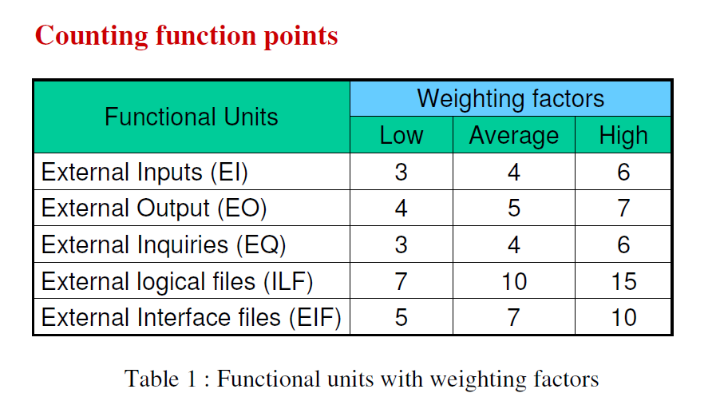
Function-Point Calculation

Slide 17
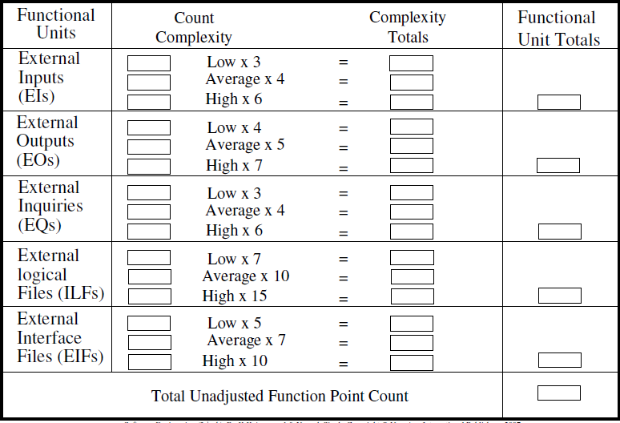
UFP Calculation

Slide 18
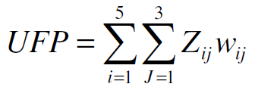
The procedure for the calculation of UFP in mathematical form is given below:
  Where i indicate the row and j indicates the column of Table 1
  Wij : It is the entry of the i^{th} row and j^{th} column of the table 1
  Zij : It is the count of the number of functional units of Type i that have been classified as having the complexity corresponding to column j.

Slide 19
Computing Function Points
Analyze information domain of the application and develop counts
Establish count for input domain and system interfaces
Weight each count by assessing complexity
Assign level of complexity (simple, average, complex) or weight to each count
Assess the influence of global factors that affect the application
Grade significance of external factors, F_i, such as reuse, concurrency, OS, ...
FP = SUM(count x weight) x C where complexity multiplier C = (0.65+0.01 x N) degree of influence N = SUM(F_i)
Compute function points

Slide 20
Function Point Computation
Identify/collect the information domain values
Complete the table shown below to get the count total
Evaluate and sum up the adjustment factors (see the next two slides)
  “F_{i}” refers to 14 value adjustment factors, with each ranging in value from 0 (not important) to 5 (absolutely essential)
Compute the number of function points (FP)
FP = count total * [0.65 + 0.01 * sum(F_{i})]
Information Weighting Factor
Domain Value Count Simple Average Complex
External Inputs _____ x 3 4 6 = _____
External Outputs _____ x 4 5 7 = _____
External Inquiries _____ x 3 4 6 = _____
Internal Logical Files _____ x 7 10 15 = _____
External Interface Files _____ x 5 7 10 = _____
Count total ________

Slide 21
Function Point Example
Information Weighting Factor
Domain Value Count Simple Average Complex
External Inputs 3 x 3 4 6 = 9
External Outputs 2 x 4 5 7 = 8
External Inquiries 2 x 3 4 6 = 6
Internal Logical Files 1 x 7 10 15 = 7
External Interface Files 4 x 5 7 10 = 20
Count total 50
FP = count total * [0.65 + 0.01 * sum(F_{i})]
FP = 50 * [0.65 + (0.01 * 46)]
FP = 55.5 (rounded up to 56)

Slide 22
Good points, bad points
Can be measured already after design
FPs can be used to estimate LOC depending on the average number of LOC per FP for a given language
LOC can vary wildly in relation to FP
FPs are very subjective — depend on the estimator. They cannot be counted automatically

Slide 23

Complexity Adjustment Factors
Rate each factor on a scale of 0 to 5.
1. Does the system require reliable backup and recovery
2. Is data communication required
3. Are there distributed processing functions
4. Is performance critical
5. Will the system run in an existing heavily utilized operational environment

Slide 24
6. Does the system require on line data entry
7. Does the on line data entry require the input transaction to be built over multiple screens or operations
8. Are the master files updated on line
9. Is the inputs, outputs, files, or inquiries complex
10. Is the internal processing complex
11. Is the code designed to be reusable
12. Are conversion and installation included in the design
13. Is the system designed for multiple installations in different organizations
14. Is the application designed to facilitate change and ease of use by the user

Slide 25
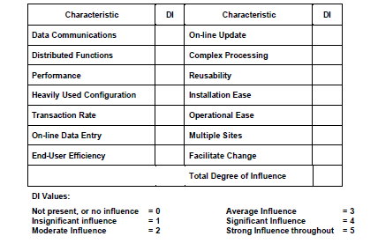

Slide 26


Slide 27
Functions points may compute the following important metrics:
  Productivity = FP / persons-months
  Quality = Defects / FP
  Cost = Rupees / FP
  Documentation = Pages of documentation per FP

Slide 28
Example
Consider a project with the following functional units:
  Number of user inputs = 50
  Number of user outputs = 40
  Number of user enquiries = 35
  Number of user files = 06
  Number of external interfaces = 04
  Assume all complexity adjustment factors and weighting factors are average. Compute the function points for the project.

Slide 29

Solution
We know that
UFP = 50 x 4 + 40 x 5 + 35 x 4 + 6 x 10 + 4 x 7
= 200 + 200 + 140 + 60 + 28 = 628
CAF = (0.65 + 0.01 Fi)
= (0.65 + 0.01 (14 x 3)) = 0.65 + 0.42 = 1.07
FP = UFP x CAF
= 628 x 1.07 = 672

Slide 30
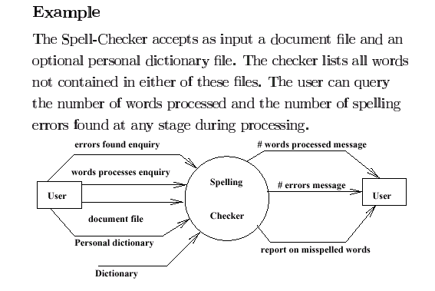

Slide 31
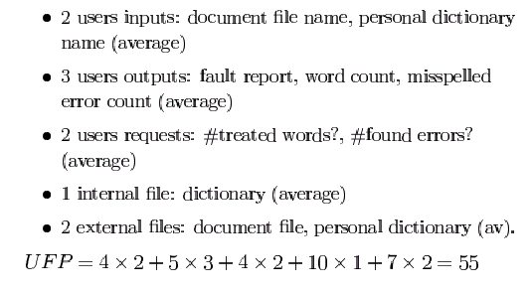
Contd…

Slide 32
Contd…
    Technical Complexity Factors:
      1. Data Communication 3
      2. Distributed Data Processing 0
      3. Performance Criteria 4
      4. Heavily Utilized Hardware 0
      5. High Transaction Rates 3
      6. Online Data Entry 3
      7. Online Updating 3
      8. End-user Efficiency 3
      9. Complex Computations 0
      10. Reusability 3
      11. Ease of Installation 3
      12. Ease of Operation 5
      13. Portability 3
      14. Maintainability 3
        DI =30 (Degree of Influence)

Slide 33
Contd…
Function Points
  FP=UFP*(0.65+0.01*DI)= 55*(0.65+0.01*30)=52.25
  That means the is FP=52.25

Slide 34
Function Points
Compute the function point value for a project with the following information domain characteristics:
  Number of user inputs: 32
  Number of user outputs: 60
  Number of user enquiries: 24
  Number of files: 8
  Number of external interfaces: 2
  Assume that weights are average and external complexity adjustment values are not important.

Slide 35
Example: SafeHome Functionality
Test Sensor
Password
SafeHome System
User
Zone Setting
Sensors
Zone Inquiry
Sensor Inquiry
Messages
Sensor Status
User
Panic Button
(De)activate
(De)activate
Monitor and Response System
Password, Sensors, etc.
Alarm Alert
System Config Data

Slide 36
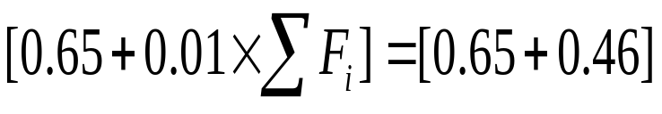
Example: SafeHome FP Calc
weighting factor
measurement parameter
count
simple avg. complex
number of user inputs
3
X
3
4
6
=
9
number of user outputs
2
X
4
5
7
=
8
number of user inquiries
2
X
3
4
6
=
6
number of files
1
X
7
10
15
=
7
number of ext.interfaces
4
X
5
7
10
=
22
count-total
52
complexity multiplier
1.11
function points
58

Slide 37
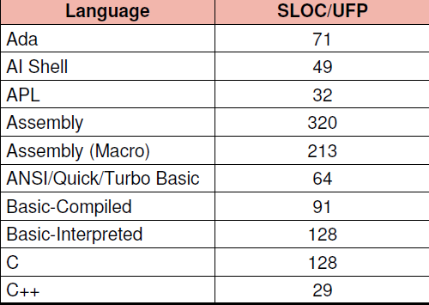
Converting function points to lines of code

Slide 38
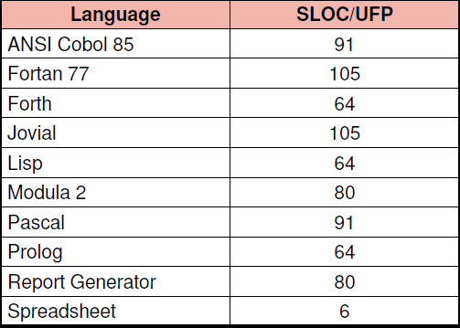
Converting function points to lines of code.

